Slide 1
Board of Visitors Induction Workshop
Ministry of Health and
Medical Services
May 2023
A presentation by Esther Williams and Losalini Tavaga
CWMH Board of Visitors 2023

Slide 2
Workshop Program
Time | Topic
0830 | Registration
0900 | Introductions
0900 | Background – Why this workshop?
 | Objectives and outcomes of the workshop
 | Overview of Board of Visitors
 | Governance – Legal Framework, key laws
1000 | Vision, mission and values
1030 | Morning tea
1100 | Terms of Reference
1130 | Roles and responsibilities of Board Members
1300 | Lunch
1400 | Donations and Fundraising
 | Coordination
 | Working with medical staff and Talanoa with hospital leadership
 | Protections for Board Members
1600 | Reflections and Evaluation
Notes:
Understanding Hospital-Based Counselling (HBC) and Mental Health Provision
What do medical and health Officers need to know?

Slide 3
Introductions
Name
Current position
Experience
Motivation for joining the Board of Visitors
Your personal objective
Expectations of today

Slide 4
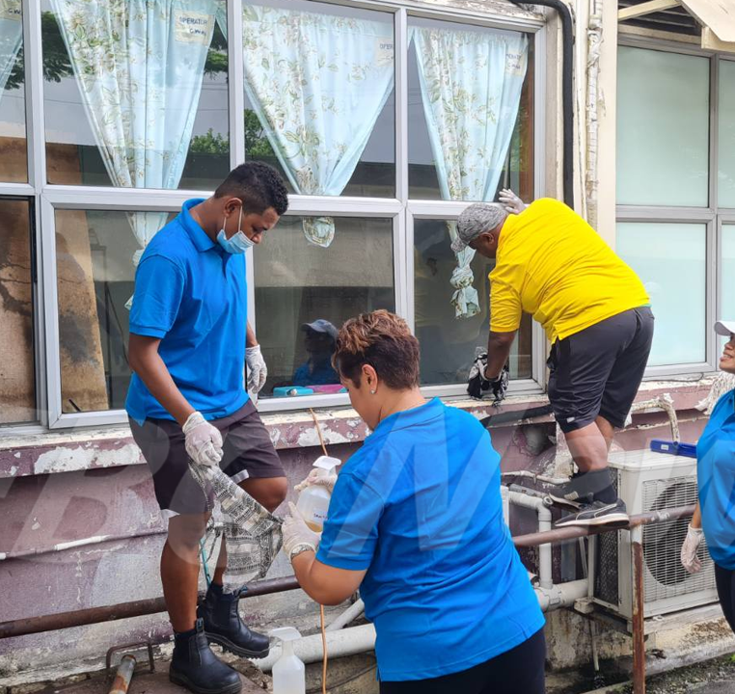
Background Why this Workshop?
Our hospitals and health centres in Fiji have come under close scrutiny over these past months.
There is now a more concerted and committed effort to improve our health care system in Fiji which makes oversight and BOV work more challenging and complex.
While hospitals have varying leadership structures, BOVs are given the task of making significant input and changes regarding health care objectives and strategic goals. However, there have been few active BOVs in the past.
To effectively carry out your roles, you are expected to help the hospitals that you have been assigned.
Tasks are complex and you are expected to work hard, giving your all for the betterment of the health care facility and its patient and staff care.
Your commitment and your time freely given should be given with love and understanding.

Slide 5
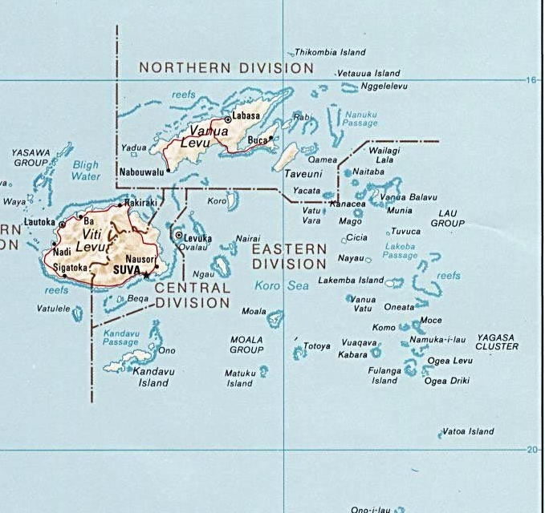
Background Continued…
POPULATION BY PROVINCES
PROVINCES | URBAN | RURAL | TOTAL
BA | 165,411 | 82,297 | 247,708
BUA | 625 | 14,841 | 15,466
CAKAUDROVE | 10,999 | 39,470 | 50,469
KADAVU |  | 10,897 | 10,897
LAU |  | 9,602 | 9,602
LOMAIVITI | 4,250 | 11,407 | 15,657
MACUATA | 27,182 | 38,801 | 65,983
NADROGA / NAVOSA | 10,293 | 48,638 | 58,931
NAITASIRI | 148,697 | 28,981 | 177,678
NAMOSI |  | 7,871 | 7,871
RA | 5,987 | 24,445 | 30,432
REWA | 93,483 | 14,533 | 108,016
SERUA | 7,005 | 13,026 | 20,031
TAILEVU | 20,320 | 44232 | 64,552
ROTUMA |  | 1,,594 | 1,594
TOTAL | 494,252 | 390635 | 884,887

Slide 6
Objectives and Outcomes
The Fijian Constitution enshrines health as a fundamental right for all citizens of Fiji. The Ministry of Health and Medical Services is responsible for ensuring that all Fijians have access to reliable, high-quality health and medical services, regardless of where they reside in Fiji, and have the knowledge to be proactive about their own health and wellbeing.
The objective of this workshop is to share with you our experiences and challenges in the managing and running a BOV so you are aware of what needs to be done, can be done and not to be done to support the Ministry of Health and Medical Services.
It is not an easy task as there is so much to do in all our hospitals to provide the care and to support the needs of our people. As well as, to support the doctors, nurses and all our health providers in their work on a daily basis.
It is a labour of love and hopefully what we share with you will help you improve the services in the hospital you serve. This outcome will be good for the sum total of health services in Fiji. Change is coming.

Slide 7
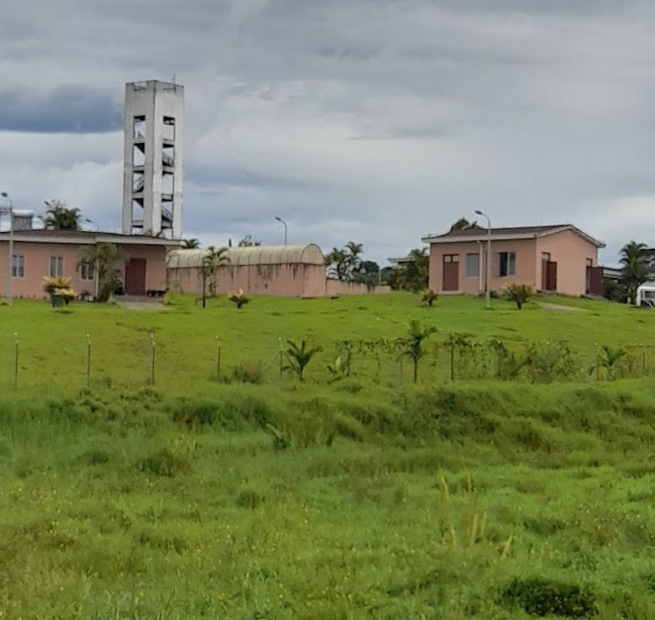
What is a Board of Visitors?
BOVs are important to any hospital or health centre as they assist in various ways.
Based on our experience, these include:
Understanding the needs of the hospital and health centre
Improving patient care
Working with the MHMS and medical staff to focus on multiple areas of improvement - infrastructure, clinical services, supplies, medicines, etc.
Financial assistance
Technical advice and assistance
Community and business partnerships
Health education and research
Policies and administrative help
Always be there to help. It is a 24/7 job at many times.
Notes:
BOVs are important to any hospital or health centre as they assist in various ways. (Recall few short experiences when joining the CWMH Board).
Based on our experience, these include:
Maybe provide some examples from each bullet point? Such as examples of how CWMH BOV has helped improve patient care?

Slide 8
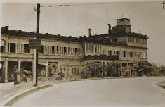
Legal Framework This presentation is similar to any other legal education materials designed to provide general information on pertinent legal topics. The statements made as part of the presentation are provided for educational purposes only.
There are 42 legislations for which the health portfolio is responsible, including the Constitution of the Republic of Fiji 2013.
Some main legislations that Board Members should know are:
Public Hospitals and Dispensaries Act (Cap110)
Public Hospitals and Dispensaries (Amendment) Regulations 2012
Public Health Act (Cap111)
Private Hospitals Act (Cap 256A)
Mental Health Decree (2010)
Medical and Dental Practitioners (Amendment) Decree 2014
Nurses Decree (2011)

Slide 9
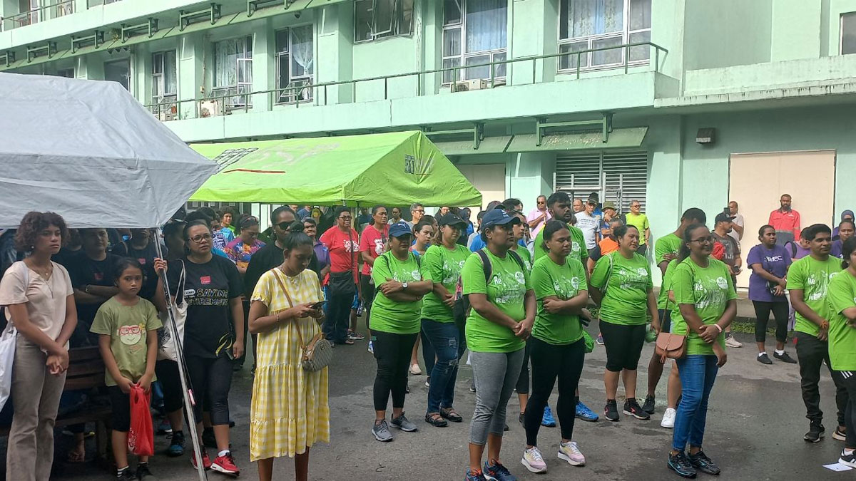
Mission, Vision and Values Example of CWM
Our Vision – Compassionate care. Improved Quality of Service. Inclusive. Every time.
Our Vision reflects our desire to provide the best practice health care in a challenging environment and aged facility with safety of patients as a priority.
Compassionate and improved high-quality care for a positive service experience to all.
Ensure financial sustainability for the hospital to meet this vision.
Our Mission - Exemplary Health Care. Clinical Excellence. A Passion for Service.
To improve, promote and protect the health of the people in the Suva community and wider Fiji; and foster the well-being and protection and care of people who feel unwanted by their families and experience disabilities; and reduce disparities.
Provide quality services to our community through a wide range of inpatient and outpatient programs focused on acute and chronic care.
With MS CWMH and staff, develop innovative programs and services to meet the unique needs of our patients.
Provide a safe, supportive environment focused on healing, prevention and wellness.
Offer learning opportunities in a community hospital setting.

Slide 10
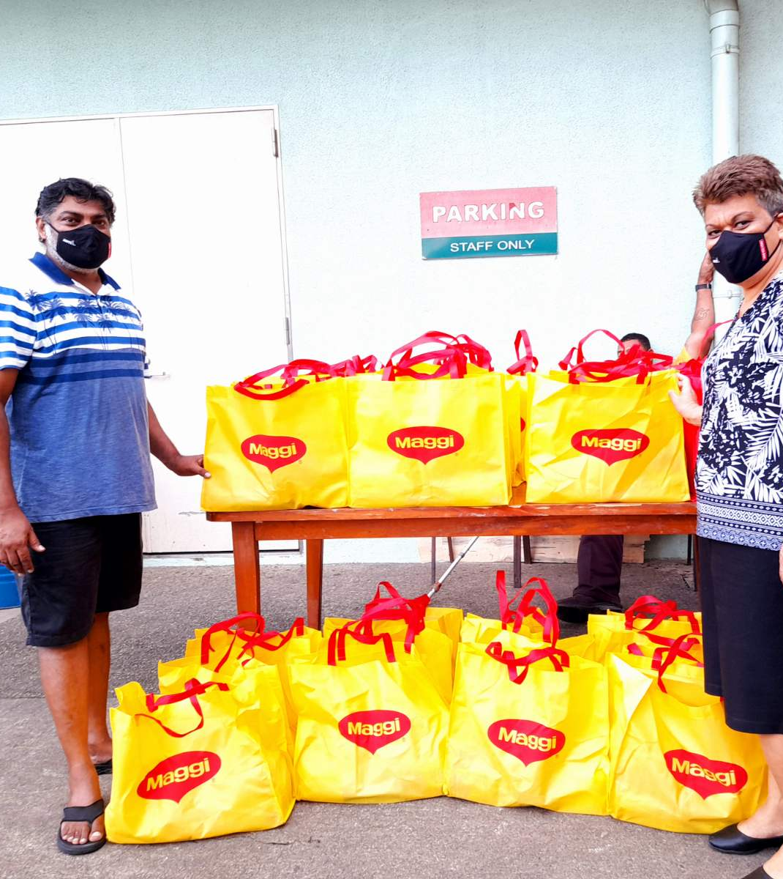
Mission, Vision and Values Example of CWM
Our Value​​​​​​​s - Compassionate care. Accountability. Responsive to needs. Respect. Best service
Care and respect for others.
Safety of patients.
Uphold cleanliness.
Integrity, commitment and love in all we do.
Responsive 24/7 in every way.
Responsibility for outcomes.
Compliant.
Always Teamwork.

Slide 11
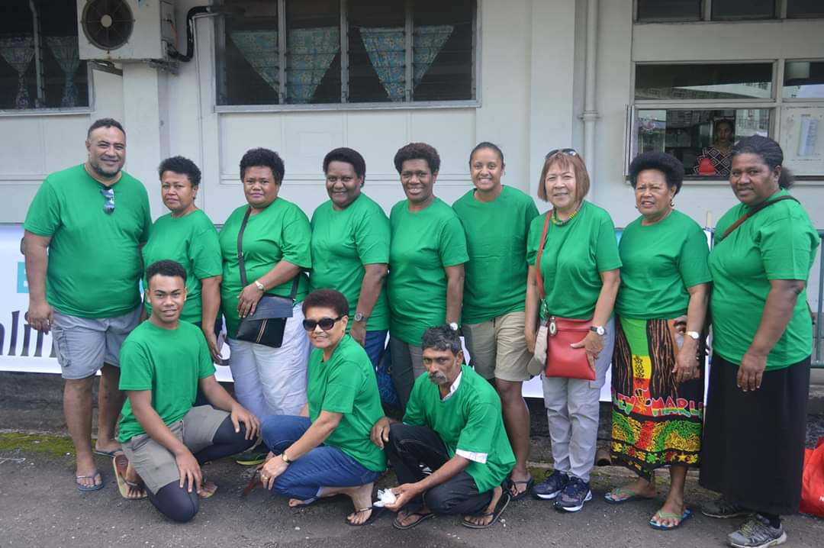
Mission, Vision and Values
Break into your respective Boards and discuss:
Why you want to be on a BOV?
What you see as important issues for the hospital you serve?
How will you bring about change?
Use your discussions to develop a draft of your BOV Vision, Mission, Values.
Group presentation.
Notes:
EW will go through with workshop participants
After 15 minutes make presentation of their discussions to the whole group present followed by discussion

Slide 12
Talanoa on Terms of Reference
Notes:
Circulate TOR for CWMH as an example.

Slide 13
Roles and Responsibilities of Board Members BOV Responsibilities
Meet hospital mission, vision and values
Responsible to the Minister of Health and Medical Services
Engage in strategic planning
Effective administration and communication especially with the Minister
Improved facilities and services
Quality patient care
Financial procurement, assistance and stability
Community private/public relations
Statutory and regulatory compliance
Board education, health education, training and efficient processes

Slide 14
Roles and Responsibilities of Board Members Responsibility continued…
Planning Prepare BOV annual plans of works with timeline, budget, and risk management plan. | 4. Strategy Foster holistic methodologies focused on improvements and health needs of the community through working with NGOs, faith and ethnic based organisations, youth groups, businesses, unions, institutions.
2. Communication Keep Minister informed on the work undertaken and proposed planned qualitative and quantitative work, including projects - Communicate through the Chair And MS. | 5. Visits Carry out regular team visits to the hospital/health centre focusing not only on health care of patients but health education for staff.
3. Funding Fundraise to assist the hospital in maintenance and other work. Develop partnerships with various business houses and donors.

Slide 15
Roles and Responsibilities of Board Members BOV Roles
Board roles may differ but based on our laws, all Boards three central roles:
Governing role for effective governance of the Board and Hospital
Advisory role to assist management and administration
Financial and general assistance role
In general, boards also have specific roles for:
Minor, Medium and Major Works
Decision making
Policy making including for services and strategic planning
Assist with management where appropriate and within TOR

Slide 16
Roles and Responsibilities of Board Members BOV Roles – Decision Making
Strategic plan input
Identify funding and donor partners
Service providers and tenders
Minor, Medium and Major works of facility
Services and Costs consideration
Health care and health education
Submit input to budgets
Notes:
Mention Minor works SOP, tracker and flow chart – available on MHMS website

Slide 17
Roles and Responsibilities of Board Members BOV Roles – Policy Making
Board should establish general policies that further the hospital mission and work.
Policies could include but not limited to:
Fundraising and Projects identification and assistance.
Naming rights.
Maintenance and upgrade works.
Private ward upgrade and care.
Clean up.
Review and input into hospital and medical staff bylaws, rules, policies.
Board delegates implementation of policies to management.

Slide 18
Roles and Responsibilities of Board Members BOV Roles – Effective Governance
Board should take an interest in the management and operations of the hospital.
Regular presentations to the Board on operations so as to get an insight into how things work.
Establish key interest in strategic plans.
Ensure policies and processes are in place.
Require and review periodic reports from administration and medical staff.
Ask appropriate questions.
Follow up on issues that arise.
Hold administration accountable.

Slide 19
Roles and Responsibilities of Board Members BOV Roles
Regarding oversight, keep in mind:
It is not the Board’s role to manage day-to-day operations itself.
You do not have the time, training, experience, and information to manage effectively.
Board needs to focus on achieving the hospital’s mission, not micromanaging operations.

Slide 20
Roles and Responsibilities of Board Members BOV Roles – Authority
You must note as in the Public Hospitals and Dispensaries Act (Cap110) Section 10:
The Board has the authority, not individual members.
Board must have quorum to act (2/3 of members to be present).
Board may delegate authority to committees or individuals.
Individual board members lack authority to act on their own unless authorized by the board.
Board member may expose themselves to liability if he or she acts outside scope of authority.

Slide 21
Roles and Responsibilities of Board Members BOV Roles – Key Board Members
Key Board Members
The Board Members play a central role in assisting the BOV in strategic decision-making. Their role affects the hospital's needs and performance as it pertains to quality health care and financial performance. Their role is to identify key supporters and financiers to help with the needs of the hospital and improve health care in the community.
The hospital BOVs will often include local business leaders, community workers, academics, lawyers, private sector leaders, doctors, nurses, and government leaders all giving of their time voluntarily.
A successful BOV comprises a team of experienced and hardworking people who are willing to give their time to the improvement of needs and welfare of the sick, hospital and health care centre.

Slide 22
Roles and Responsibilities of Board Members BOV Roles – Key Board Members
CHAIR
Leads, oversees and coordinates board and executive committee meetings, setting the agenda and direction. Develops annual objectives and action plans, guides needs, priorities, strategic plans, activities. The board chair also serves as the spokesperson and a voice of the Board to the rest of the hospital staff and to the community.
SECRETARY
The role of the Secretary is of central importance. They work with the Chair to put together the meeting agendas, papers, record all discussions in meetings, produce the minutes and distribute these in a timely manner prior to meetings to all Board members. The secretary is responsible for maintaining the official records of the Board meetings.
TREASURER
Serves as a financial advisor and is responsible for keeping and producing complete and accurate financial reports for the approval of the Board. Overall, the treasurer manages the health care BOV cash flow, bank accounts, and debt management. And is responsible for the Annual Audit.
Notes:
Chair
Chair is a key position. It is the chair that keeps the BOV moving no matter what. You must give it the time and commitment.
Oversee and coordinate board and meetings.
Set the agenda and direction.
Develop annual objectives and action plans, guide needs, priorities, strategic plans, activities.
Point of communication with Minister and MS and PS, and MOH
The board chair also serves as the spokesperson and a voice of the board to the rest of the hospital staff and to the community.
Always looking out for assistance
Always open and spend time meeting with donors and other providers
There is a need for a good Secretary - a central importance.
Works closely with the Chair to put together the meeting agenda, papers, record all discussions in meetings, produce the minutes and distribute these in a timely manner.
The secretary is responsible for maintaining the official records of the board meetings and keeps the Board members informed.
Also responsible for overseeing the quality of meetings and attendance. Formal KPIs for Board being developed. Keeps records.
Success of a BOV depends on this position. (EW to state experience here with CWMH BOV)
At this point Losalini Tavaga to take over
Describe work/responsibility as Secretary and touch on:
Agenda
Notice of Meeting
Minute taking
Minutes in timely manner
Chair and Secretary working together
Communicating with Board members
Sending out notices of meetings etc, reports, minutes to members
KPIs
Experiences
Treasurer (EW)
Serves as a financial advisor.
Getting the BOV registered with FRCS and application for tax exempt approval as government body.
Responsible for keeping and producing complete and accurate financial reports for the approval of the board.
Overall, the treasurer manages the health care BOV cash flow, bank accounts, and debt management.
Responds to donors and provides receipts for all donations, etc
Responsible for the Annual Audit to be done by an independent auditor – due 31st March annually. This is crucial task to be compliant. This is submitted to Minister on or before 31 March of the next year. So 2022 Annual Audit submitted to Minister before 31 March 2023

Slide 23
Roles and Responsibilities of Board Members BOV Roles – Key Board Members
KEY RESPONSIBILITIES OF THE CHAIR
The Chair keeps the BOV moving no matter what.
Oversee and coordinate Board and meetings.
Set the agenda and direction.
Develop annual objectives and action plans, guide needs, priorities, strategic plans, activities.
Point of communication with Minister and MS and PS, and MHMS.
Serves as the spokesperson and a voice of the Board to the rest of the hospital staff and to the community.
Identifies new opportunities for assistance.
Meeting with donors and other providers.
Notes:
There is a need for a good Secretary - a central importance.
Works closely with the Chair to put together the meeting agenda, papers, record all discussions in meetings, produce the minutes and distribute these in a timely manner.
The secretary is responsible for maintaining the official records of the board meetings and keeps the Board members informed.
Also responsible for overseeing the quality of meetings and attendance. Formal KPIs for Board being developed. Keeps records.
Success of a BOV depends on this position. (EW to state experience here with CWMH BOV)
At this point Losalini Tavaga to take over
Describe work/responsibility as Secretary and touch on:
Agenda
Notice of Meeting
Minute taking
Minutes in timely manner
Chair and Secretary working together
Communicating with Board members
Sending out notices of meetings etc, reports, minutes to members
KPIs
Experiences
Treasurer (EW)
Serves as a financial advisor.
Getting the BOV registered with FRCS and application for tax exempt approval as government body.
Responsible for keeping and producing complete and accurate financial reports for the approval of the board.
Overall, the treasurer manages the health care BOV cash flow, bank accounts, and debt management.
Responds to donors and provides receipts for all donations, etc
Responsible for the Annual Audit to be done by an independent auditor – due 31st March annually. This is crucial task to be compliant. This is submitted to Minister on or before 31 March of the next year. So 2022 Annual Audit submitted to Minister before 31 March 2023

Slide 24
Roles and Responsibilities of Board Members BOV Roles – Key Board Members
KEY RESPONSIBILITIES OF THE SECRETARY
Works closely with the Chair to put together the meeting agenda, papers, record all discussions in meetings, produce the minutes and distribute these in a timely manner.
Responsible for maintaining the official records of the Board meetings and keeps the Board members informed.
Responsible for overseeing the quality of meetings and attendance.
Tracking formal KPIs for Board and maintaining records.
Success of a BOV depends on this position.
Notes:
There is a need for a good Secretary - a central importance.
Success of a BOV depends on this position. (EW to state experience here with CWMH BOV)
At this point Losalini Tavaga to take over
Describe work/responsibility as Secretary and touch on:
Agenda
Notice of Meeting
Minute taking
Minutes in timely manner
Chair and Secretary working together
Communicating with Board members
Sending out notices of meetings etc, reports, minutes to members
KPIs
Experiences

Slide 25
Roles and Responsibilities of Board Members BOV Meeting Agenda Example
Meeting: | CWMH Board of Visitors Meeting No.2/23
Venue: | MOH Admin Conference Room, High Street, Toorak, Suva
Date: | Thursday 16th February 2023 Time: 4.00pm
AGENDA
Opening Prayer
Welcome
Confirmation of minutes of the previous meeting 19 January 2023
Matters Arising
Update on Working Group – TOR, SOP Minor Works
Update on other Minor Works required by CWMH
Follow up approval and commencement of Minor Works Tailevu/Namosi Ward
Clean up day 25th February 2023
100 years Celebrations of CWMH
Fundraising
Tripartite Agreement
Management Report
Other Matters

Slide 26
Roles and Responsibilities of Board Members BOV Meeting Minute Example
MINUTES OF THE CWM HOSPITAL BOARD OF VISITORS NO. 4/23 HELD AT THE ADMIN CONFERENCE ROOM ON 22nd MARCH 2023 AT HIGH STREET, TOORAK, SUVA
PRESENT IN ATTENDANCE
APOLOGY ABSENT
AGENDA ITEM | DISCUSSION | DECISION | MEMBER RESP | TIMELINE
1. ETC

Slide 27
Roles and Responsibilities of Board Members BOV Roles – Treasurer
KEY RESPONSIBILITIES OF THE TREASURER
Serves as a financial advisor.
BOV registration with FRCS and application for tax exempt approval as government body.
Responsible for keeping and producing complete and accurate financial reports for the approval of the Board.
Overall, the treasurer manages the BOV cash flow, bank accounts, and debt management.
Responds to donors and provides receipts for all donations.
Responsible for the Annual Audit to be done by an independent auditor – due 31st March annually.
The Annual Audit is crucial task to be compliant. The Annual Audit is submitted to Minister on or before 31 March of the next year. For example, the 2022 Annual Audit was submitted to Minister by 31 March 2023.

Slide 28
Roles and Responsibilities of Board Members BOV Roles – Fiduciary Duties (Treasurer)
Getting set up:
REGISTRATION OF BOV with FRCS
TIN NUMBER
BANK ACCOUNT AND NUMBER – Bank is Board decision.
BANK CHEQUE BOOK/ONLINE BANKING
TO GET THESE, WHAT IS NEED?
An authorisation Letter from MHMS with appointment letters of all Board members.
Minutes of meeting confirming signatories: usually suggest 3-4 recommended as members are busy and work to be shared
Start early as the process takes time: work of Treasurer and Chair

Slide 29
Donations, Fundraising and Projects
BOVs working with MS are in a position to raise money in various ways, including, partnerships to form business ventures, donations, aid from international and local agencies for the welfare of the hospital meeting its patients needs.
Before any fundraising drive is undertaken, the Chair must inform and get the approval of the PS.
Minor works/projects up to $50,000.00 can be undertaken by the Board working with MS of the Hospital.
Letter of Commitment to be signed by donor, MS and BOV (refer to Minor Works SOP).
Projects above $50,000.00, inform PS on any financial approaches to be made. Any agreement from any of these must be approved by PS before any signing is undertaken.
Agreement on assistance must be signed between PS, Donor and BOV should this be the case.

Slide 30
Coordination
Coordination at all levels is important to get work progressing. Including with:
MHMS staff at every level.
Donors, including aid from various countries and international organisations.
Contractors of all types and in all areas.
Old scholars.
Other key partners, including business, NGOs, etc.

Slide 31
Working with Medical Staff
Nothing can progress without a good working team comprising of both the BOV and Medical Staff.
It is important in the Agenda of monthly meetings to have a management report presented. Always request for a paper on items the BOV may wish to learn more about.
Keep a close eye on community needs as many may approach you for assistance. You must help where you can and most times you must work with the hospital staff.
Be more caring and know your staff. Be supportive.
Always ask questions and also provide ideas and suggestions for improvement.
If you have an idea(s) make it known to staff and the Board.
Always be involved in all related matters to the hospital you are responsible for as BOV.

Slide 32
Talanoa on Hospital Setting & Expectations
Notes:
DON Millie
Mike Cama

Slide 33
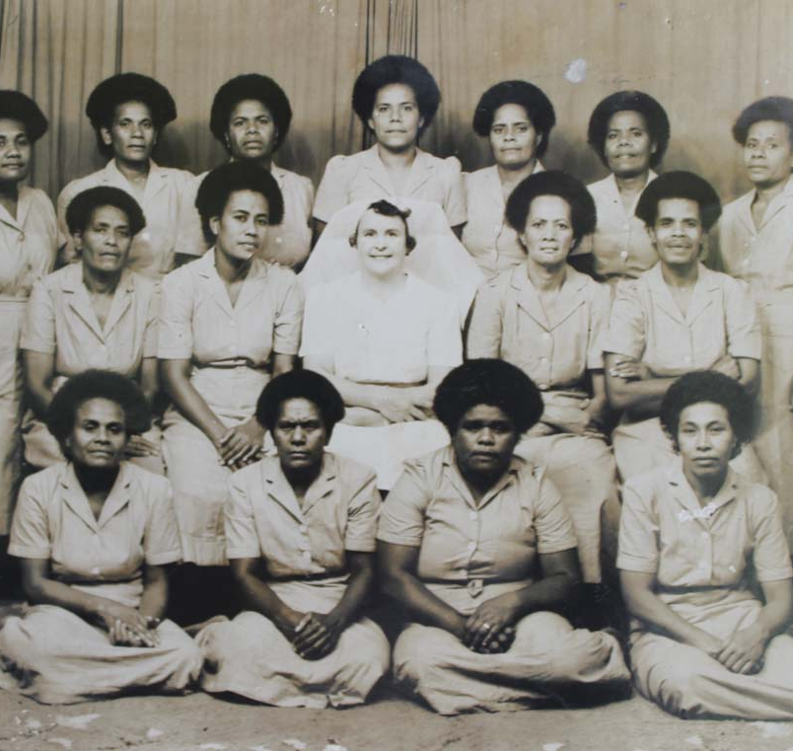
Protections for the Board Members
There are some important considerations for undertaking the work as a member of a BOV:
All work is on voluntary basis and that means we are all responsible for our health and well being. However, the hospital and health centres go out of their way to provide tea at meetings, and transport home if needed.
During COVID-19 we continued to work in hospitals irrespective of the known risks. We continued with work knowing full well our situation. This risky environment must be understood by all as the MHMS is unable to take out insurance for individuals – that is my understanding. We take out our own through our work or other ways. We all have medical cards. We cannot blame the hospitals for any risks that may befall us.

Slide 34
Our Team - CWMH BOV
Dr. Esther Williams |  | Losalini Tavaga |  | Admond Chandra |  | Jitesh Patel
Chair |  | Secretary |  | Treasurer |  | Member
Sitiveni Marovia |  | Gitesh Nair |  | Viti Whippy |  | Nemani Tuifagalele
Member |  | Member |  | Member |  | Member
Our commitment
We are passionate about our undertaking and believe in giving 110% of our effort, time and commitment to the BOV and hospital we serve. By using our combined and collective knowledge, skills and experiences, we are confident that the outcome of our work will meet the expectations of the Minister of Health and Medical Services. Strengthening the BOV in its work to improve healthcare and services in the various hospitals and health centres in Fiji is a priority. Amidst all the needs and concerns raised from various sources, there is no time to lose in ensuring proactively transforming our hospitals and health centres in Fiji to serving the health needs and health education and research of all our people.
Notes:
Note – all BOVs should have a commitment statement

Slide 35
Reflection on Vision, Mission and Values
Break into your respective Boards and discuss your previous reflections on:
Why you want to be on a BOV
What you see as important issues and part of the whole
How will you bring about change
Use your discussions to update your draft of your BOV Vision, Mission, Values.
Group presentation.
Notes:
After 15 minutes make presentation of their discussions to the whole group present followed by discussion

Slide 36
What next?
Hold your first meeting
Who contacts members to set this up?
What should the agenda include?
Review skills, experience and network of the Board Members
Decide roles of secretary and treasurer
Set up bank account
Tour of hospital and meet leadership
Set date/time for monthly meetings
Review existing documents – templates and examples from CWM
Notes:
After 15 minutes make presentation of their discussions to the whole group present followed by discussion

Slide 37
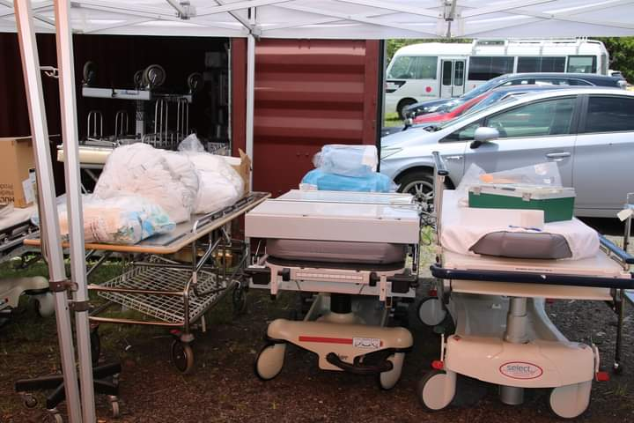
Thank You
ESTHER WILLIAMS
LOSALINI TAVAGA
CWMH BOV

